Slide 1
CSE422: Artificial intelligence
How Machines Learn
Linear Regression, Logistic Regression, Gradient Descent
Asif Shahriar
Lecturer, CSE, BRACU

Slide 2
Machine Learning Tasks
Machine learning tasks can be divided into three broad categories
Supervised Learning
Learns from labeled training data (input-output pairs)
The model “supervises” itself by making predictions for input data and comparing the with known answers (right: okay, wrong: improve)
Used for prediction tasks like spam detection, price forecasting
Unsupervised Learning
Works with unlabeled data to find patterns, groups or structures
Example: clustering (grouping customers into segments based on buying behavior), dimensionality reduction, anomaly detection
Reinforcement Learning
The algorithm learns by interacting with an environment, making decisions, and receiving feedback in the form of rewards or penalties
Applied in robotics, game playing, and self-driving cars

Slide 3
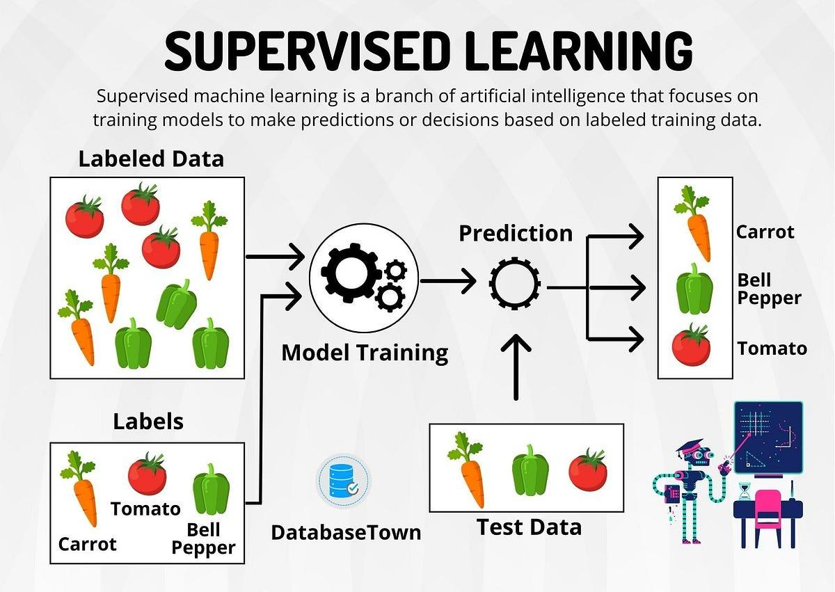
Supervised Learning

Slide 4
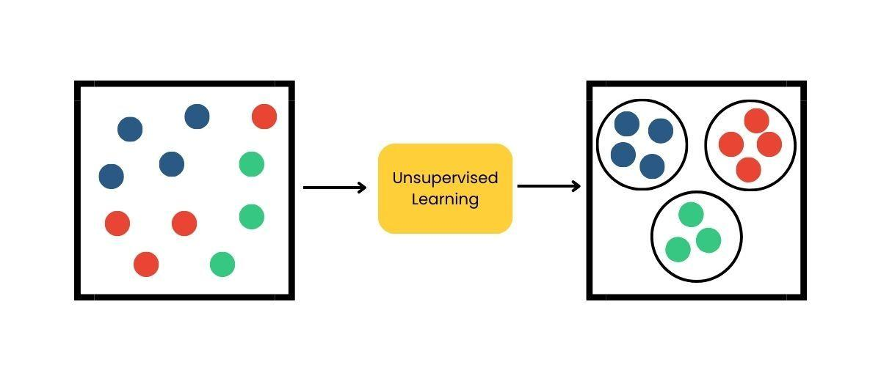
Unsupervised Learning

Slide 5
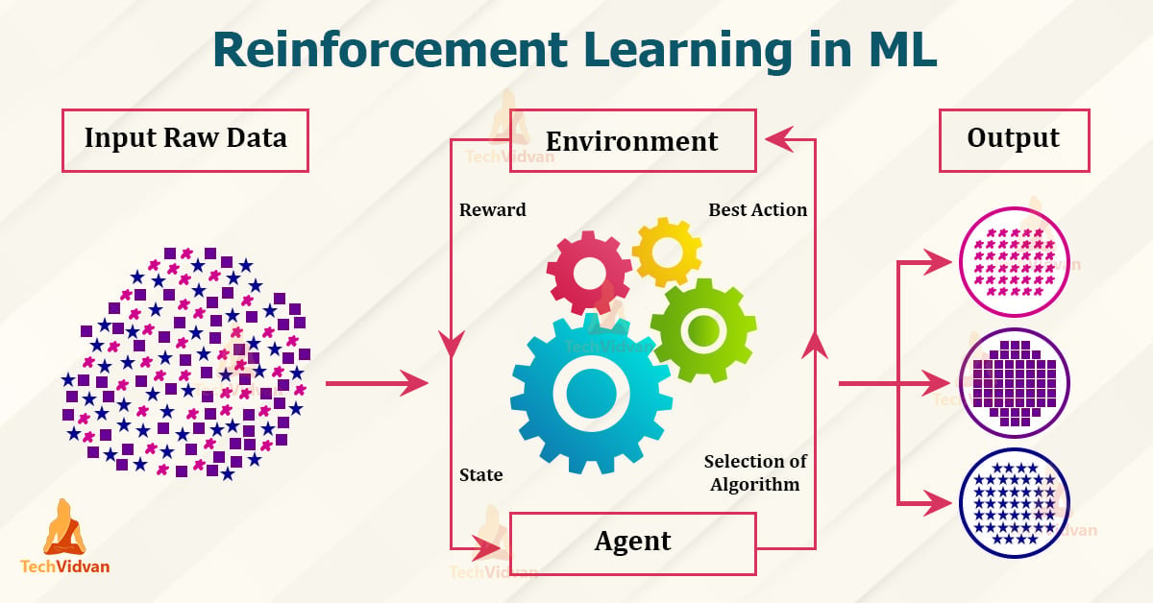
Reinforcement Learning

Slide 6
Supervised Learning
Supervised Learning can be of TWO types
Regression
Predicts a continuous numerical value based on input features
Example: Estimating house price from size, location, and number of rooms.
Classification
Predicts a discrete class label from input data
Example: Classifying an email into <spam, ham>, identifying emotion from a social media post <happy, sad, angry, fearful, sarcastic>

Slide 7
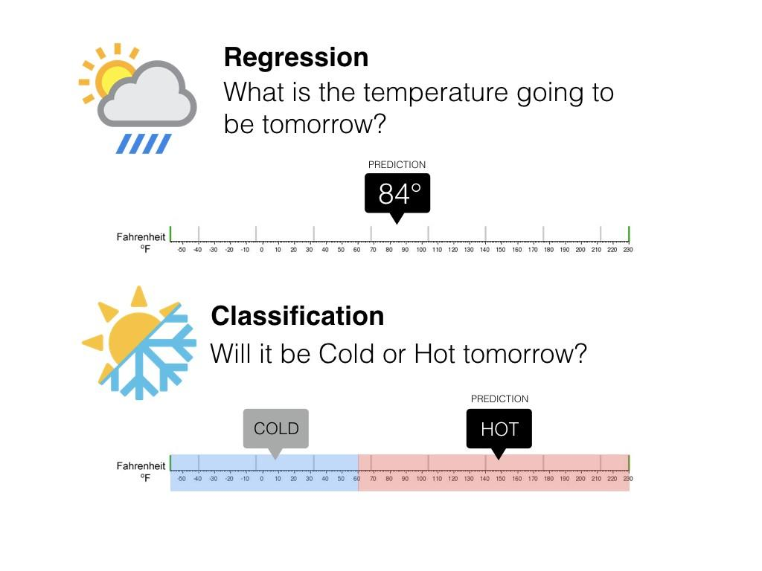
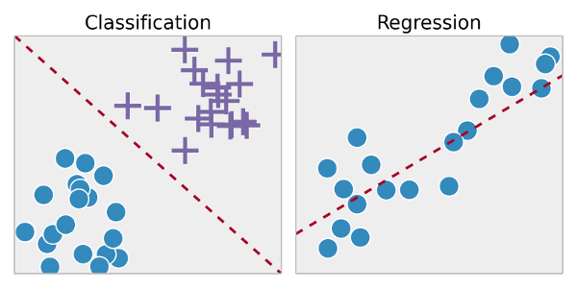
Supervised Learning

Slide 8
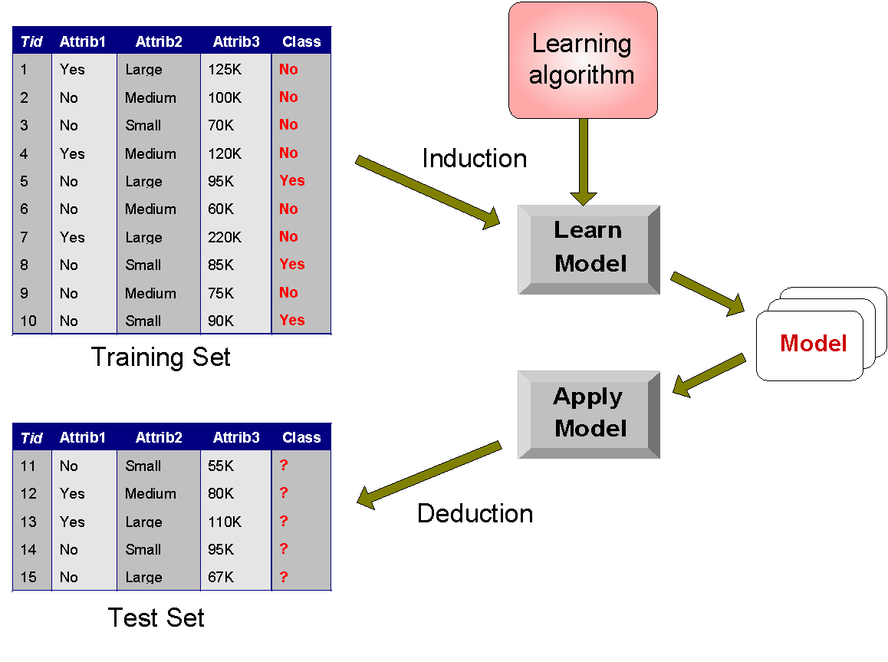
Train-Test Set

Slide 9
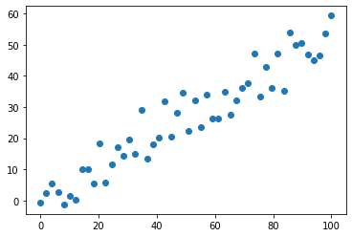
Linear Regression

Slide 10
Linear Regression
The most straightforward (and very powerful) regression model is a Linear model
Here we assume that the features (x) and the target (y) have a linear relationship
In other words, we try to FIT a straight line on the dataset
For each input x_{i}, we predict the output (target) as h_{w}(x) = w₀ + w₁ x
w₀ and w₁ are called model parameters or weights, we need to find their optimal values during training
w₀ (the constant term) is often called “bias”
We compare our prediction h_{w}(x) with the actual output y to check how right or wrong our current model is

Slide 11
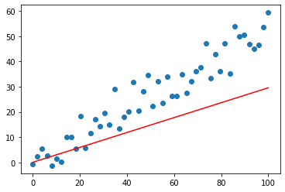
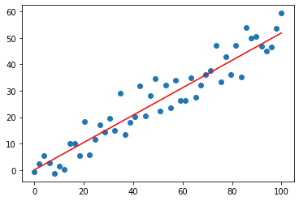
Linear Regression
Here are TWO linear regression models (straight lines) fit on the same data.
Which model is better?

Slide 12
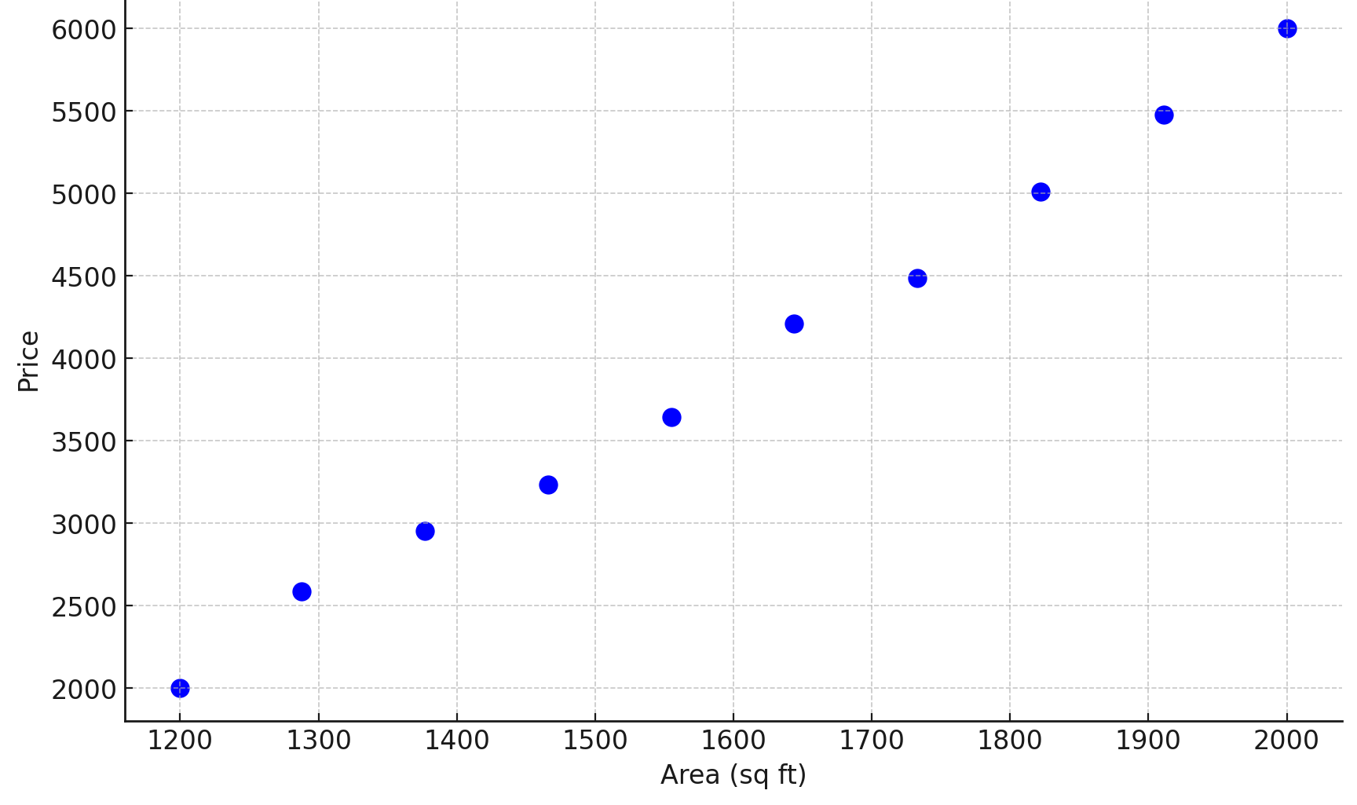
A Mini-Housing Dataset
Area (x) | Price (y)
1200 | 2000
1288 | 2588
1377 | 2955
1466 | 3236
1555 | 3646
1644 | 4208
1733 | 4485
1822 | 5012
1911 | 5476
2000 | 6000

Slide 13
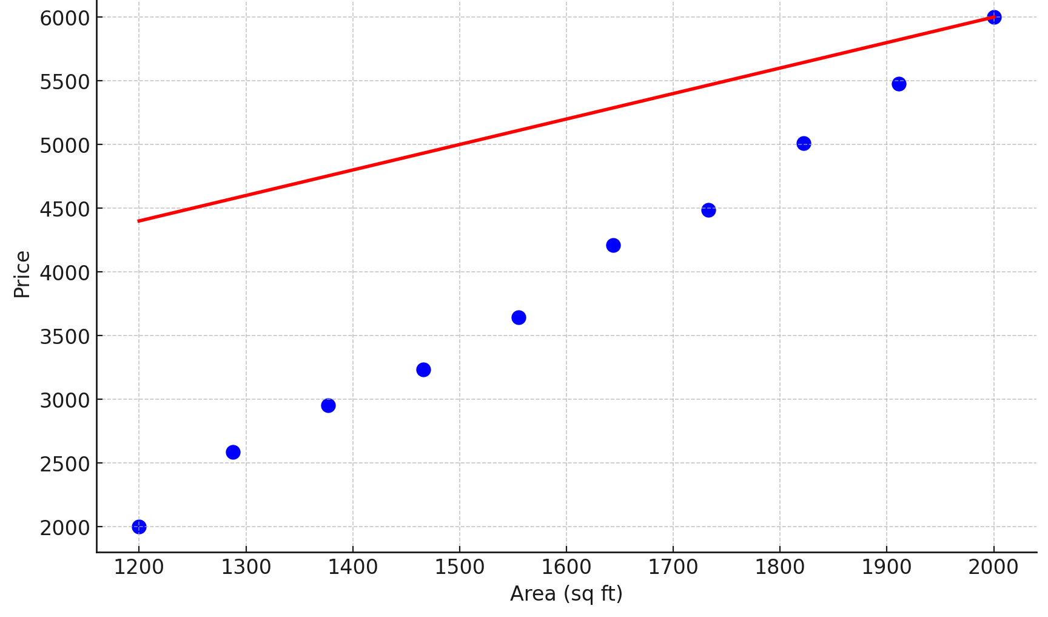
Linear Regression: Model Building
Let our initial model be h(x) = 2x + 2000
x: feature
h(x): predicted output (price)
y: actual output (price)
Here w₀ = 2000, w₁ = 2
Area (x) | Price (y) | Predicted= h_{w}(x)
1200 | 2000 | 4400
1288 | 2588 | 4576
1377 | 2955 | 4754
1466 | 3236 | 4932
1555 | 3646 | 5110
1644 | 4208 | 5288
1733 | 4485 | 5466
1822 | 5012 | 5644
1911 | 5476 | 5822
2000 | 6000 | 6000

Slide 14
Linear Regression: Loss Function
After we get predictions using our initial linear model, we need to determine the “goodness” of the current model (how good the model performs)
The most common approach is to use a loss function
A loss function measures how bad the current model is
Our goal is to minimize the loss function
The choice of loss function depends on the problem. For regression, we can use the following loss functions:
Absolute Error (AE): |y - h_{w}(x)|
In practice we use Mean Absolute Error (MAE): |y - h_{w}(x))| / N
Squared Error (SE): (y - h_{w}(x))²
In practice we use Mean Squared Error (MSE): (y - h_{w}(x))² / N
Also called L2 loss function

Slide 15
Linear Regression: Loss Function
Area (x) | Price (y) | Pred=h(x) | AE | MAE | SE | MSE
1200 | 2000 | 4400 | 2400 | 2400 | 5760000 | 5760000
1288 | 2588 | 4576 | 1988 | 2194 | 3952144 | 4856072
1377 | 2955 | 4754 | 1799 | 2062.333 | 3236401 | 4316182
1466 | 3236 | 4932 | 1696 | 1970.75 | 2876416 | 3956240
1555 | 3646 | 5110 | 1464 | 1869.4 | 2143296 | 3593651
1644 | 4208 | 5288 | 1080 | 1737.833 | 1166400 | 3189110
1733 | 4485 | 5466 | 981 | 1629.714 | 962361 | 2871003
1822 | 5012 | 5644 | 632 | 1505 | 399424 | 2562055
1911 | 5476 | 5822 | 346 | 1376.222 | 119716 | 2290684
2000 | 6000 | 6000 | 0 | 1238.6 | 0 | 2061616
 |  |  | 12386 | 1238.6 | 20616158 | 2061616

Slide 16
Linear Regression: Model Update
Once we have the loss/error values, we need to update the model to make it better
This is done by updating the model parameters
We want to select new values for our parameters that minimizes the current loss function
For this we use Gradient Descent

Slide 17
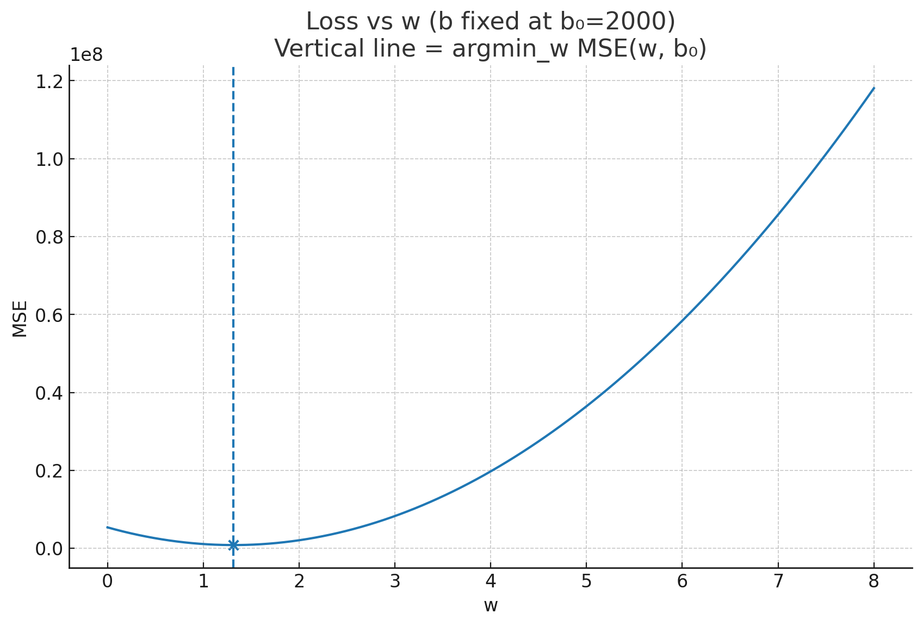
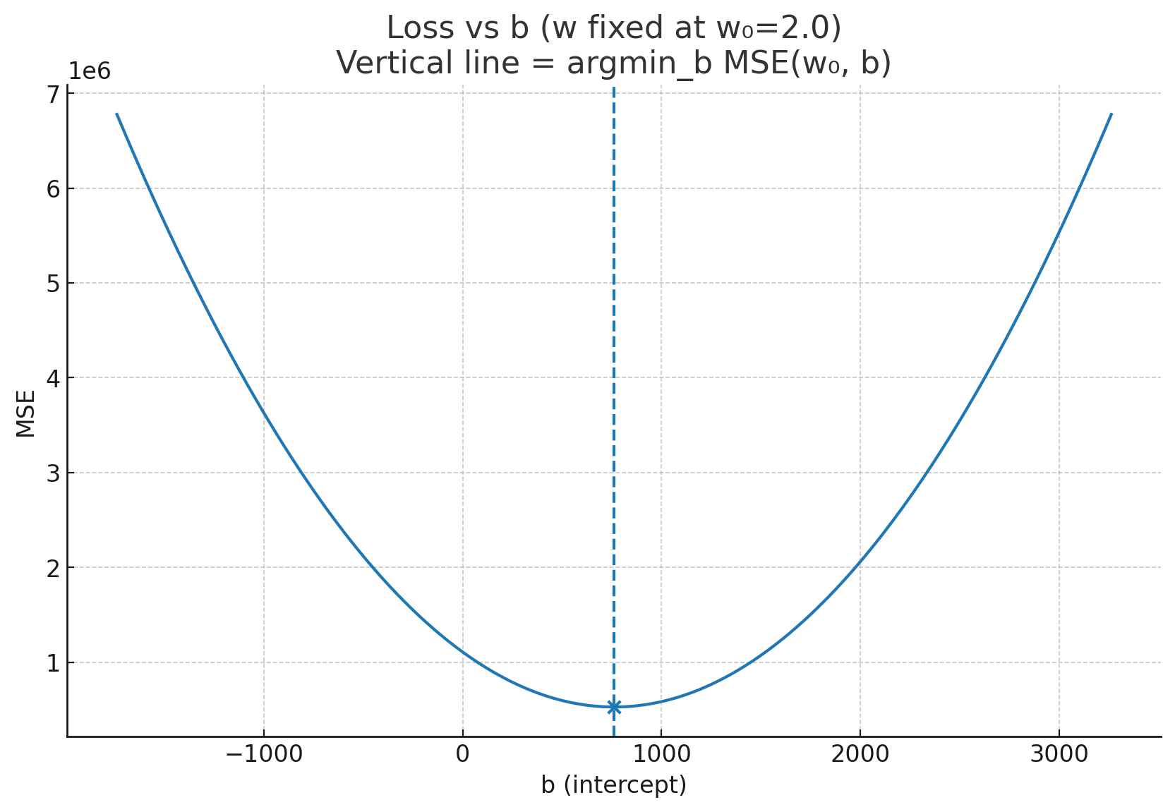
Gradient Descent
We want to choose new values for w₀ and w₁ that minimize the L2 loss function (MSE):
(y - h_{w}(x))² / N

Slide 18
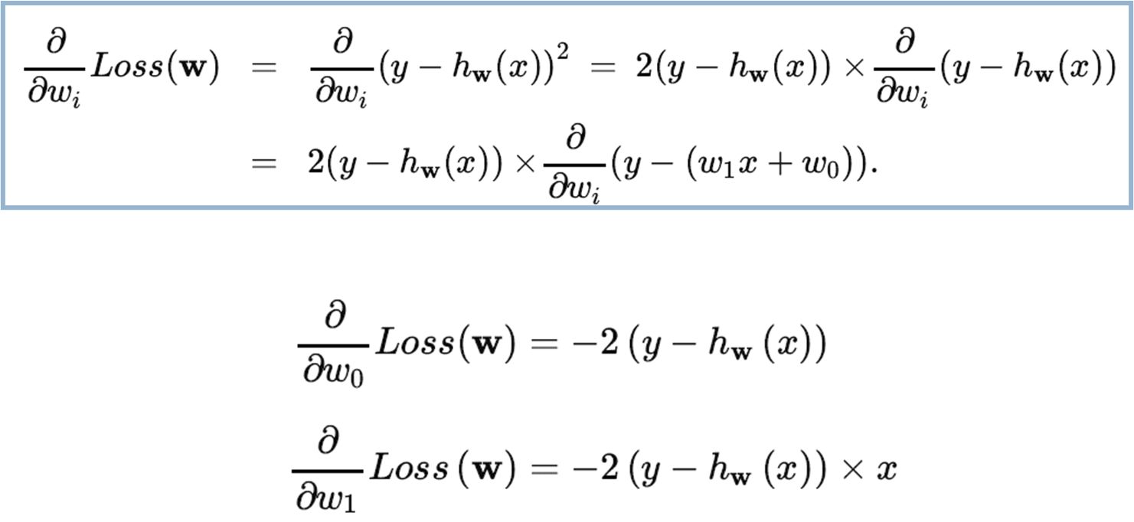
Gradient Descent

Slide 19
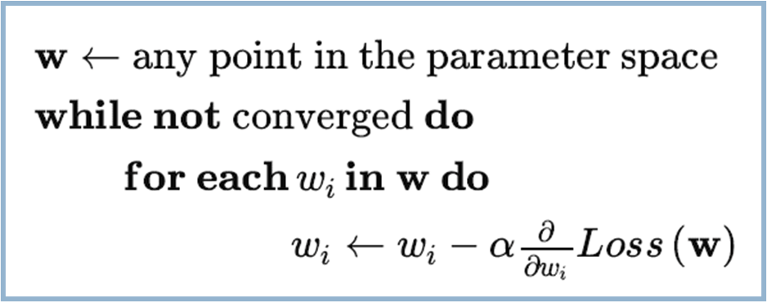
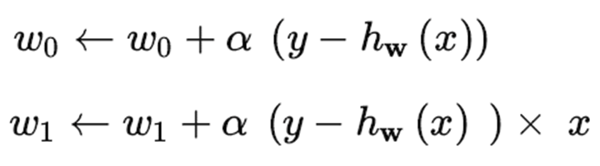
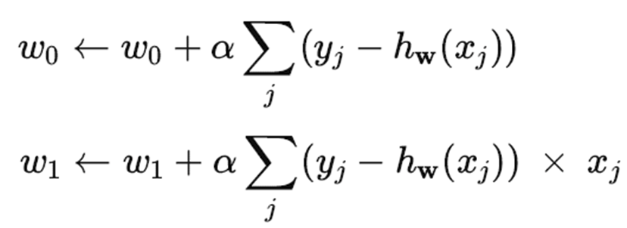
Gradient Descent
For single example:
For entire training set:

Slide 20

Performing Gradient Descent
Area (x) | Price (y) | Pred=h(x) | y-h(x) | [y-h(x)]x
1200 | 2000 | 4400 | -2400 | -2880000
1288 | 2588 | 4576 | -1988 | -2560544
1377 | 2955 | 4754 | -1799 | -2477223
1466 | 3236 | 4932 | -1696 | -2486336
1555 | 3646 | 5110 | -1464 | -2276520
1644 | 4208 | 5288 | -1080 | -1775520
1733 | 4485 | 5466 | -981 | -1700073
1822 | 5012 | 5644 | -632 | -1151504
1911 | 5476 | 5822 | -346 | -661206
2000 | 6000 | 6000 | 0 | 0
Sum |  |  | -12386 | -17968926
Let
w₀ = 2000 + (1e-8)(-12386) = 1999.999987
w₁ = 2 + (1e-8)(-17968926) = 1.82

Slide 21
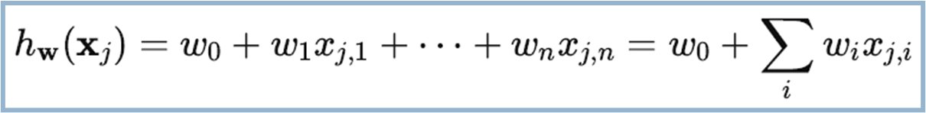
Multi-variable Linear Regression
Linear regression is not limited to a single feature only
If there are multiple features, we can extend Linear Regression model naturally:
We can use Linear Regression to model non-linear relationships too!

Slide 22
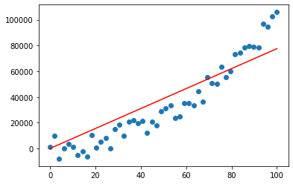
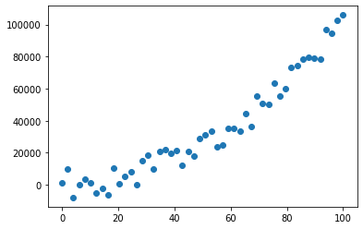
Linear Regression for Non-Linear Relations
A linear function (straight line) does not quite fit
Just extend the model! h_{w}(x) = w₀ + w₁ x + w₂ x²

Slide 23
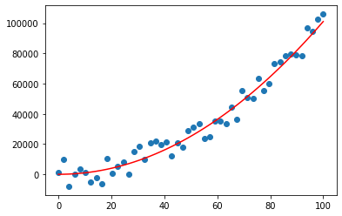
Linear Regression for Non-Linear Relations

Slide 24
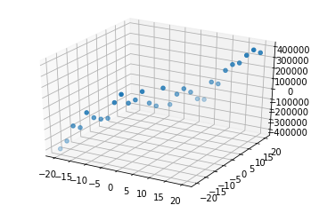
Linear Regression for Non-Linear Relations

Slide 25
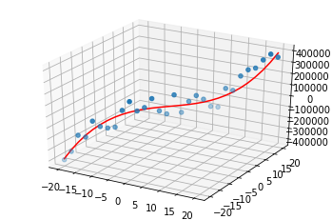
Linear Regression for Non-Linear Relations

Slide 26
But what about Classification?
Hours Study | Pass
2 | No
3 | No
4 | Yes
5 | No
6 | Yes
7 | Yes
8 | Yes
9 | Yes
10 | ?
Hours Study | Pass
2 | 0
3 | 0
4 | 1
5 | 0
6 | 1
7 | 1
8 | 1
9 | 1
10 | ?
Here, let’s say we are trying to predict whether a student is going to pass based on hours study
Hours study, in this case is the feature and Pass, is a label
Pass is a categorical variable consisting of two values {Yes, No}
This is a classification problem [binary classification]

Slide 27
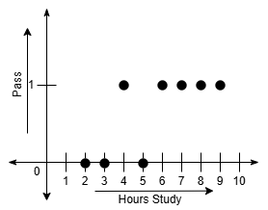
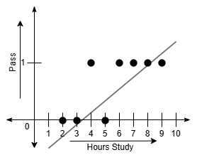
But what about Classification?
Let’s try to plot the dataset
Hours Study | Pass
2 | 0
3 | 0
4 | 1
5 | 0
6 | 1
7 | 1
8 | 1
9 | 1
10 | ?
Does not fit
Linear models cannot fit non-linear classification data

Slide 28
Linear Model for Classification?
So how to fit a linear model to non-linear classification problem?
By passing the linear output through a non-linear activation function
For binary classification, a suitable non-linear activation function is sigmoid function
Linear function: z = w₀ + w₁ x
Sigmoid function: σ(z) = 1 / (1 + e^{-z}) [σ(z) is called Logit]
This is called Logistic Regression (note: this is NOT actually regression, it is classification. We keep the regression word because the idea originally came from Linear Regression)

Slide 29
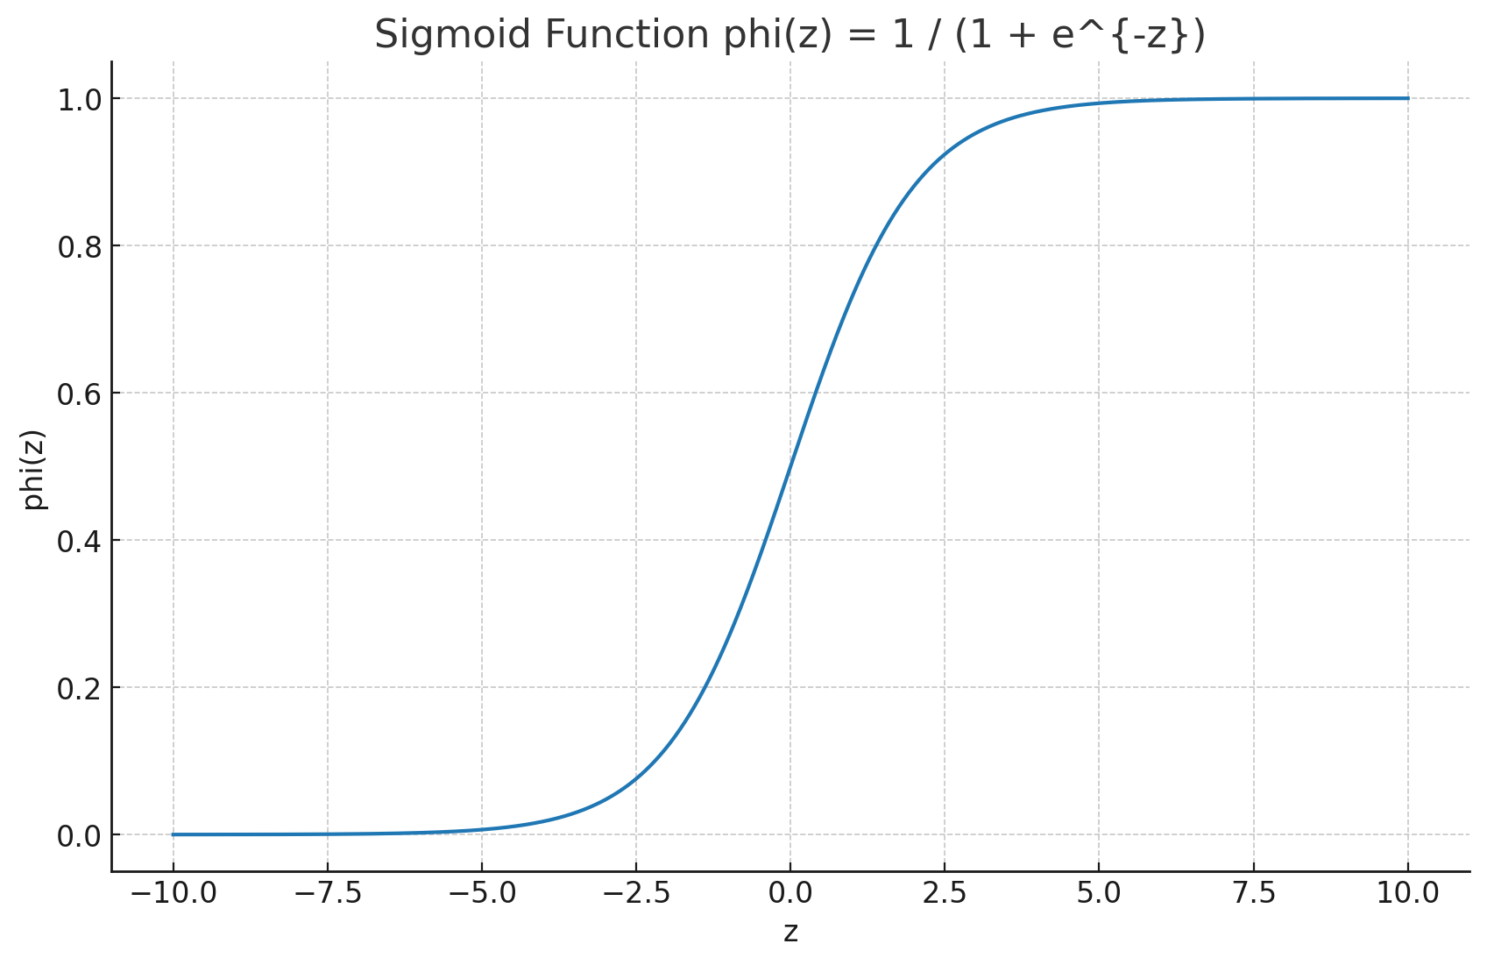
Sigmoid Function
z | σ(z) | z | σ(z)
-10 | 4.50E-05 | 1 | 0.731059
-9 | 0.000123 | 2 | 0.880797
-8 | 0.000335 | 3 | 0.952574
-7 | 0.000911 | 4 | 0.982014
-6 | 0.002473 | 5 | 0.993307
-5 | 0.006693 | 6 | 0.997527
-4 | 0.017986 | 7 | 0.999089
-3 | 0.047426 | 8 | 0.999665
-2 | 0.119203 | 9 | 0.999877
-1 | 0.268941 | 10 | 0.999955
0 | 0.5

Slide 30
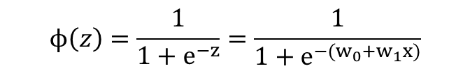
Logistic Regression for Classification
z = w₀ + w₁ x
Using sigmoid function, we get the logits:
For binary classification, these logits are compared with a fixed threshold, i.e. 0.5
If Φ(z) > threshold, prediction y’ = 1, else y’ = 0
Compare the prediction y’ against the true label, y
For binary classification, loss is calculated using Binary Cross-Entropy (BCE) loss

Slide 31
Intuition behind BCE Loss Function
If y = 1 and σ(z) = 0.000005 [Extreme case of misclassification]
loss = -1.log0 - (1-1).log(1-0) = 5.301 [High loss value]
If y = 1 and a = 1 [Best case of correct classification]
loss = -1.log1 - (1-1).log(1-1) = 0 [Low loss value]
If y = 0 and σ(z) = .000095 [Extreme case of misclassification]
loss = -0.log1 - (1-0).log(1-1) = 4.022 [High loss value]
If y = 0 and a = 0 [Best case of correct classification]
loss = -0.log0 - (1-0).log(1-0) = 0 [Low loss value]

Slide 32

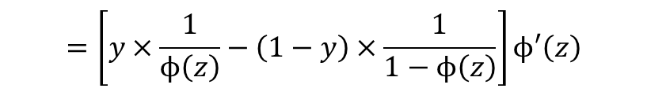
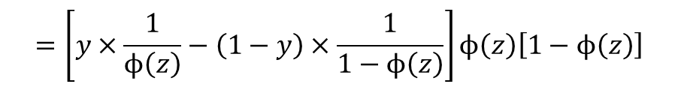


Logistic Regression for Classification
Updating parameters using gradient descent:

Slide 33

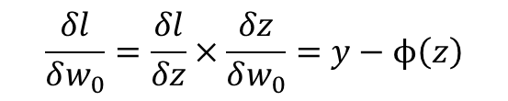
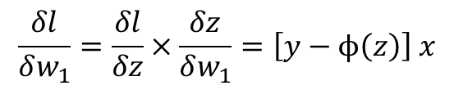
Logistic Regression for Classification
Since z = w₀ + w₁ x,
Using chain rule,
Does it look familiar?
Similar to linear regression

Slide 34
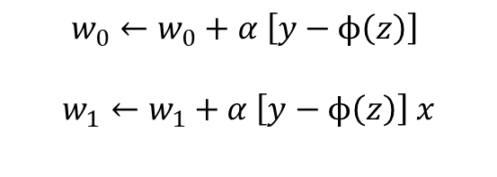
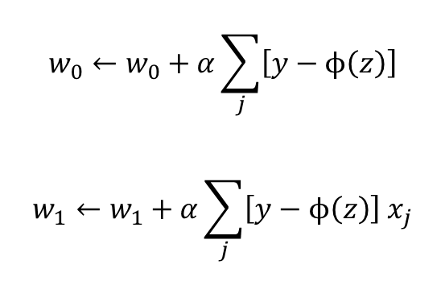
Logistic Regression for Classification
For single data point:
For entire training set:

Slide 35
Summary of Logistic Regression Steps
Take z = w₀ + w₁ x with randomly initialized w₀ and w₁
Pass through sigmoid function to get the logit σ(z) [for Binary classification]
Compare the logit against threshold to get the predicted value y’
Compare y’ with y, calculate the loss
Apply gradient descent to update w₀ and w₁
Repeat

Slide 36


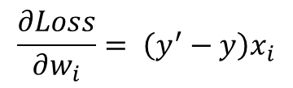
Logistic Regression for Classification
You are training a logistic regression model with two input features
The prediction is: where
Input features: x₁ = 1 and x₂ = 2
Bias: b = 0
True label: y = 1
Initial weights: w₁ = 0.2 and w₂ = – 0.4
Learning rate,
Based on these, answer the following questions:
Compute the value of z and the predicted output y'.
Using Binary Cross-entropy loss given as perform one step of gradient descent to update the weights.

